Slide 1


RAK Courts Department
Annual Report 2020

Slide 2
The Courts Department Obtained 3 Awards in the 15th "Excellence Government Award" whose ranks thereof are:
First place
Category ( Best Entity
in Providing Information of Services)
Second Place
Category ( Best Website
for Services Providers )
Second Place
Category (Best Innovative Service Initiative) – Judgments and Referential Decision Enforcement Initiative with "Saad" Company)

Slide 3
Customers Survies Results conducted by the Saqr Government Excellence Programme at the RAK Government's level, and Courts Department Achieved First Place as Follows:
91% first place
Customers’ satisfaction index during the COVID-19 crisis
87% First place
Social media channels' satisfaction index
90% first place
E-services' satisfaction index
90% third place
Smart services' satisfaction index
86% third place
Website's satisfaction index
32% increase in the usage of e-services

Slide 4

The Message of the Department's President:
In the Ras Al Khaimah Courts Department, we strive for effective and continuous development, performance enhancement, service upgrades, and the ability to face and overcome challenges to achieve the highest levels of institutional excellence. We work within the Courts Department with a forward-looking vision that embodies wise leadership, keeping pace with the future, anticipating developments, and aligning with modern advancements. We invest in all potentials, opportunities, and available chances for improvement. The Department has accomplished numerous judicial and administrative achievements, made possible by an exceptional team that works with a spirit of unity to reach the pinnacle, driven by a commitment to serve the nation and ensure customer happiness.
Chancellor Ahmed Mohammed Al Khatri
RAK Courts President

Slide 5

Message of the General Director
At RAK Courts Department, we are advancing at an accelerated pace, racing against time to position the Department among the world’s leading judicial institutions and secure top rankings for our Courts, elevating the UAE’s name on all platforms. We are contributing to the national government’s strategy, keeping pace with the era of modern technology and global judicial advancements. By integrating cutting-edge smart technologies and adopting the best international practices, we have launched strategic initiatives such as the "Paperless Courts" program. As part of this initiative, we have introduced remote litigation services, including video communication for inmates in correctional and rehabilitation facilities, virtual hearings for detainees, and remote case registration and inquiry services. These achievements, realized in a short time, reflect our commitment to pioneering advancements in the judicial sector, supporting the UAE’s ambitious development journey, and fulfilling the visionary aspirations of our wise leadership.
Ras Al Khaimah Courts Department operates with a long-term national vision aligned with the UAE National Agenda 2021, the UAE Centennial 2071, and the strategic directions of the Ras Al Khaimah government. Committed to upholding the rights of all, the Department adheres to its vision of "Pioneering Justice for a Happy Society," ensuring a modern judicial system that protects the rights, freedoms, and responsibilities of all community members. Notably, the Department was recognized as the world’s fastest court in resolving commercial cases, according to the World Bank’s 2018 report, affirming its global standing. Furthermore, the Department places significant emphasis on partnerships, forging strategic collaborations with both the public and private sectors to enhance court operations, expedite service delivery, and support governmental integration efforts, all in pursuit of achieving its vision.
With determination and persistence, we will continue to anticipate the future, leverage artificial intelligence technologies, and cultivate a work environment abundant in innovation, creativity, and healthy competition. Our goal is to achieve our strategic objectives, align with the nation's aspirations, and realize the vision of our wise leadership. We will harness all resources and capabilities, dedicating them to serving the country and all segments of society.
Ibrahim Ahmed Al Za’abi
Director General of RAK Courts Department

Slide 6
General Framework of Courts Department

Slide 7
RAK Courts’ Department Strategy
Vision
Leading Justice for a happy community
Mission
Achieving justice and legal protection for the community by utilizing qualified human cadres, modern technologies, and effective cooperation with all competent authorities
Institutional Values:
Justice
Independence and Credibility
Excellence and Innovation
Transparency
Loyalty and Belonging
Social Responsibility

Slide 8
Enhancing confidence in the judicial system and raising the level of competitiveness
Enhancing the role of amicable resolution and judicial mediation in achieving stability and community happiness
Enhancing the services of institutional development and innovation
Enhancing the relationship with the partners and community
Excellence in providing services and improving the customer experience
RAK Courts Department Strategic Objectives

Slide 9
Jurisdictions of RAK Courts
Court of First Instance
Court of Appeal
The Court of Cassation
It is the first level of litigation where to litigants resort to claim their rights or obtain any court service nevertheless the kind of right claimed or service applied as long as being within the scope of laws and regulations and no matter these rights are valuated or not. To obtain these rights and services by customers, Court has been divided into partial and plenary circuits pursuant to the lawsuit value in civil lawsuits and severity of crime in criminal lawsuits.
  It is unusual phase of litigation in which judgments issued in respect of criminal, civil, commercial, labor and personal status articles and had depleted regular methods of appeal, shall be subject to objection in cassation, in order to check the same to verify the compliance thereof with the law, whether in terms of substantive rules applied thereby or in terms of procedures to which the court adduced in issuing these judgments.
  It is the second level of litigation where to litigants resort if First-Instance judgment rendered in any of civil, criminal or personal status articles is inadmissible. Litigants therein have the right to appeal on the First-Instance judgment before Appeal Court, in cases other than those excluded by Law, to amend or cancel the same.

Slide 10
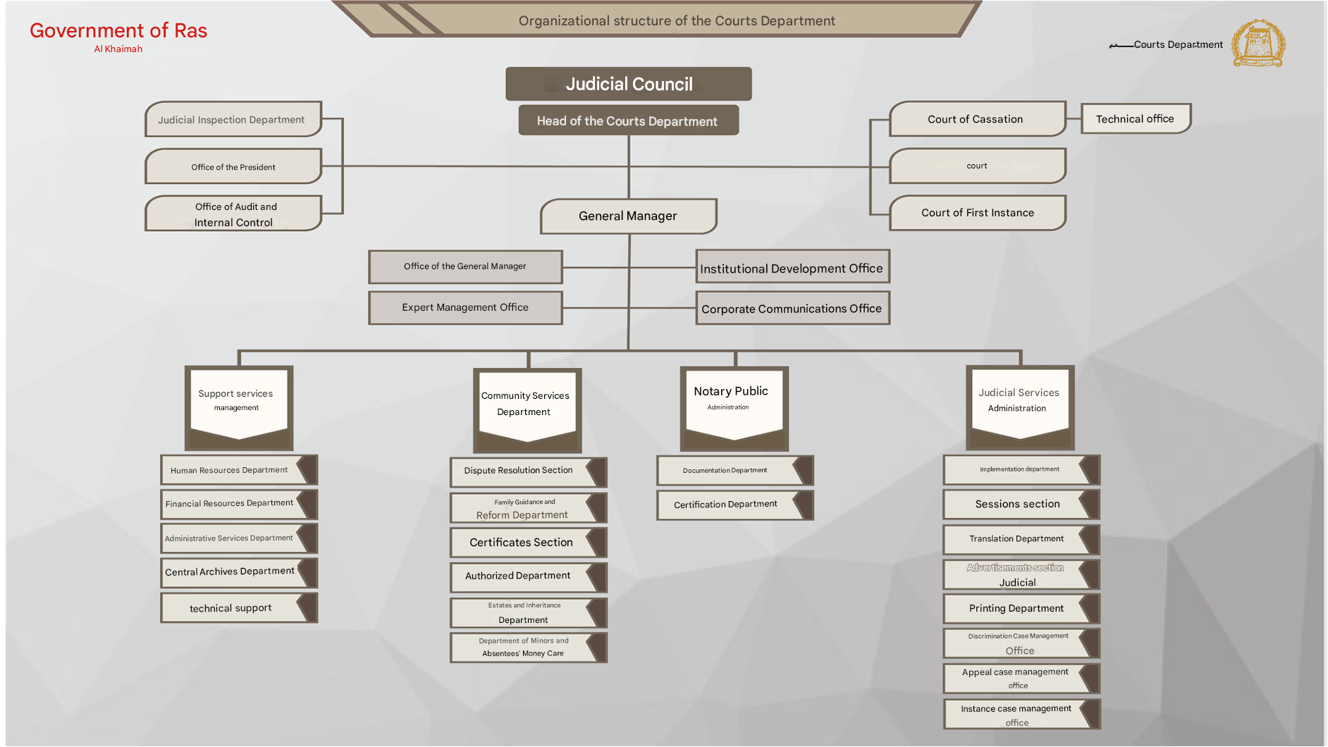

Slide 11
Projects and Initiatives

Slide 12
Judicial Mediation
RAK Courts launched the "Mediation and Amicable Settlement Section in Civil and Commercial Disputes" as an alternative way of disputes resolution through voluntary, confidential, and expeditious procedures to bring the litigants' points of view closer, and the same is carried out by Judicial Mediator composed of one or more judges and a panel of legal and administrative persons assigned to facilitate negotiations and achieve mutually acceptable settlement between litigants.

Slide 13
Remote Litigation Sessions
During this year, the Courts Department launched the remote litigation sessions system, which contributed effectively to work continuation during the COVID-19 pandemic. It is worth mentioning that these sessions were open to the public, as individuals may attend the sessions held by the courts remotely via video conference technology through the Webex Meet program and choose the smart room number specified for each judicial district.
42 Judicial Districts
22,039 Judicial Sessions
20,370 Remote Sessions
92% Online Session

Slide 14
Online payment
The Courts Department has introduced two new payment channels to ease the process of fees and trusts payment. These payments can be made online using the account of one of the parties or executives, eliminating the need for checks or bank notes. This shall reduce the burden on the court's trust fund and minimize the risk of manual errors during the payment process. Additionally, it enhances monitoring and oversight of the financial processes.
These easy and flexible channels include:
Government of Ras Al Khaimah’s website
The Smart App of MRAK
MBME self-service devices
Deposit to bank account
78,645 Payment Transactions for a Total Amount of AED 362,096,983.97

Slide 15
In cooperation with the E-Government, RAK Courts have completed the first paperless file for temporary and summary actions of petitions and fieri facias. This new system enables individuals, companies, banks, and attorneys to file a petition or a fieri facia electronically, allowing competent staff within the courts’ department to review the request. Such request shall be referred electronically to the competent judge, who shall review it along with all relevant data, including parties, demands, facts, and supporting documents through the courts’ system. A decision shall be rendered and signed electronically, after which it is sent to the competent staff to follow up on the execution of orders and decisions, ensuring that all stages of the new system are fully electronic, eliminating the need for paper.
Paperless File for Temporary Cases
4 Electronic Payment Channels

Slide 16
Prisoners Remote Prosecution
In partnership with the penal institution, online video communication has been implemented to eliminate the litigation term and shorten the terms while fulfilling all judicial guarantees for the accused and prisoners during trials. Such service has contributed to reducing the operational costs associated with providing judicial services to all prisoners while also improving the customer experience by saving time and effort in accessing the judicial services.
354 Remote Prosecution Sessions

Slide 17
E - Judge
A system has been activated to attest the decisions on judicial requests electronically by the members of the judiciary to ensure the completion of requests in record time, aiming at customer satisfaction.
45562 Electronic Judicial Decision

Slide 18
REMOTE SERVICES
Within the electronic and smart system and approach towards (paperless courts), RAK Courts aim to establish an infrastructure of electronic services and provide all services through the RAK E-Government website, RAK Courts website, or "mRAK" smart application. It also aims to provide all services remotely to the different segments of customers whether individuals, businesses, or governments. This will enhance the quality of judicial services offered to the public, which increases their satisfaction, expediency, and ease of access to "remote services" without spatial and temporal limitations, leading to saving them time, effort, and costs.
283 Online Services
92% Percentage of Online Services
75% Percentage of Online Services Usage

Slide 19
Transparency of Judgments
Ras Al Khaimah Courts has launched the "Published Judgments" service on its website for the first time, allowing customers to view and review judgments rendered by all jurisdictions across all levels of litigation: First Instance, Appeal, Cassation, and One-day Court cases.
It has been launched to enhance the principle of transparency, build confidence in the judicial system, raise awareness and legal knowledge among various segments of society, and contribute to elevating the Kingdom of Saudi Arabia's global standing in the World Bank Index “Enforcement of Contracts.” It includes judgments issued by commercial, civil, and labor jurisdictions at all levels of litigation, benefiting all concerned members of society, researchers, lawyers, and university students in legal disciplines. They can access the merits of the judgment and the verdict thereof on the website, along with the litigation timeline from the date of filing to the date of adjudication.
3,534 Published Judgments

Slide 20
Enforcement of Judgments and Referential Decisions
Yesterday, RAK Courts and "Saed" for Traffic Systems, affiliated with the Ministry of Interior, launched “Saed” patrols for the enforcement of judgments. The service employees are granted law enforcement authority to execute judgments rendered by judges, acting as executive sheriffs for the judgments rendered by the courts of the Emirate. The launch of the new service aligns with the directives of the Government of Ras Al Khaimah to expedite adjudication procedures in the execution of provisions, thereby reducing the enforcement period for judgments rendered by the department. This initiative contributes to the implementation of the State's vision and strategy, which aims to achieve swift justice for all litigants and ensure their rights.
2 Days to Provide the Service
21% Cost Reduction
76% Saved Time in Judgments Enforcement

Slide 21
Statistics

Slide 22
2020 Overall Court Performance (First Instance/Appeal/Cassation)
4989 Filed cases 4917 Adjudicated 98.77% Adjudication Percentage
2020 2019 2018

Slide 23
Commercial Cases towards Leadership and Global Competitiveness
1,530 Commercial cases 1,477 Rendered 97% Adjudication Percentage 149
Cases Carried forward to 2020

Slide 24
Court of First Instance - 18 Judicial Circuit
3911 Filed Cases3842 Adjudicated 99% Adjudication Percentage
2020 2019 2018

Slide 25
Court of First Instance - 18 Judicial Circuit
3911 Filed Cases3842 Adjudicated 99% Adjudication Percentage
2020 2019 2018

Slide 26
Court of Appeal
893 Filed Cases 891 Adjudicated 99.7% Adjudication Percentage
2020 2019 2018
2020 2019 2018
2020 2019 2018
2020 2019 2018
2020 2019 2018

Slide 27
Court of Cassation
185 Filed Cases 184 Adjudicated 99.45% Adjudication Percentage
2020 2019 2018
2020 2019 2018
2020 2019 2018
2020 2019 2018
2020 2019 2018

Slide 28
Small Claims Courts
139 Filed Cases 11 Reconciliation 99% Adjudication Percentage
2020 2019
2020 2019
(2018 , 2019 , 2020)
One-Day Court
1005 Filed Cases 989 Reconciliation 100% Adjudication Percentage
(2018 , 2019 , 2020)
(2018 , 2019 , 2020)
(2018 , 2019 , 2020)

Slide 29
Judgments Enforcement
2845 Registered Enforcing Files 452 Registered Files Expired in 2020 689 Expired Files from Previous Years
2020 2019 2018
2020 2019 2018
2020 2019 2018
2020 2019 2018
2020 2019 2018

Slide 30
Service Of Process Section
15,566 Service of Process14842 Served Notices 13027 Notices by Calling 2005 Notices in Person 41 Ban Notices
2020 2019 2018
2020 2019 2018
2020 2019 2018
2020 2019 2018
2020 2019 2018
2020 2019 2018

Slide 31
Authentication and Attestation
(2018 , 2019 , 2020)
(2018 , 2019 , 2020)
2019/2020
(2018 , 2019 , 2020)
(2018 , 2019 , 2020)
(2018 , 2019 , 2020)

Slide 32
Family Reform and Year of Tolerance
975 Family Disputes 366 Families Protected from Family Disintegration
(2018 , 2019 , 2020)
(2018 , 2019 , 2020)
(2018 , 2019 , 2020)
(2018 , 2019 , 2020)
(2018 , 2019 , 2020)
(2018 , 2019 , 2020)

Slide 33
E. Investment in Human Capital

Slide 34
National Cadres
(2018 , 2019 , 2020)
(2018 , 2019 , 2020)
(2018 , 2019 , 2020)
(2018 , 2019 , 2020)

Slide 35
Development and Training of Human Talents
(2018 , 2019 , 2020)
(2018 , 2019 , 2020)
(2018 , 2019 , 2020)
(2018 , 2019 , 2020)
(2018 , 2019 , 2020)
(2018 , 2019 , 2020)

Slide 36
Employee Happiness - Internal Survey
(2018 , 2019 , 2020)
(2018 , 2019 , 2020)
(2018 , 2019 , 2020)
(2018 , 2019 , 2020)
(2018 , 2019 , 2020)
(2018 , 2019 , 2020)

Slide 37
Autonomous Judicial Services on RAK E-Government Portal

Slide 38
Case Registration
Legal Request
Registration of Judgments'’ Execution
Execution Requests
Case Inquiry
Deposits Payment
Lawyers Services
Parties Services
Banks and Companies Services
Printing Offices Services
Judges Services
Testimonies Services
Inheritance Services
POA Services
Contracts Services
Judicial notices Services
Judicial Declarations Services
Judicial Requests Services

